Slide 1
ECEN 350 Electronic Devices and Circuits
Introduction and Circuit Analysis Review

Slide 2
Spiritual Thoughts
Please volunteer throughout the semester to share a short spiritual thought at the start of each class period.
See Spiritual Thought Sign-Up Sheet in the Week 1 module or the Course Specifics Module in Canvas.
to sign up for a specific date or dates to share a thought.

Slide 3
Grading Overview
20% Prepare Reading and Post Discussion Quizzes
20% Homework
20% Labs
Encouraged to collaborate, but turn in your unique work submission and not someone else's.
Software Labs to be done individually, although you are encouraged to help others out.
Midterm and Final exams in the Testing Center with access to an Equation Sheet, along with your personal calculator and 3 X 5 note card.
30% Exams
15% Final.
No makeups for these quizzes. Lowest 6 quiz scores for the semester dropped.
15% Midterm
10% Design Project
Student project involving design and constructi of a power supply, to be done individually.
Projects graded on submitted project report which includes performance measurements.
Can work in pairs for hardware labs, using VirtualBench equipment in STC-215.

Slide 4
ECEN 350 - ebook and Software
Text: The text “Electronic Principles” 9th Edition, Malvino, Bates and Hoppe, is required for this course.
Through a company named Vitalsource, BYU-Idaho provides Automatic Access to an ebook version of this text through I-Learn for all enrolled in the class, for a 5 year time period. You will automatically be billed a cost of approximately $46 for ebook access, with payment due after the semester drop deadline. If you have made other arrangements for a text, such as purchasing a hardcopy version, then you can opt out of the $46 charge on your account. In addition to the ebook, you can pick up a loose leaf hardcopy version of the text at the Bookstore for an additional $35. You will need to either have your loose leaf copy spiral bound (< $10.00 at the copy center) or purchase a binder, with three-ring binders available at the Bookstore.
To access the ebook text go to the Course Materials link found amongst the many links located on left-hand side of the Canvas course Home page. Note: You must create a Vitalsource account (Username and password) to access the ebook.
After you have created an account, it is best to access the ebook through Vitalsource rather than Canvas.
LTspice & MATLAB
Also download and install LTspice from the Analog Devices web site using the following link: LTspice. While not required for ECEN 350, MATLAB is another helpful resource. See the following link for instructions: MATLAB Installation Instructions.

Slide 5
iClicker for In-Class Quizzes
We will be using the iClicker Student Mobile app for phones or laptops for in-class quizzes.
If you already have an iClicker account using your BYU-I email then you will automatically be enrolled.
If you are new to iClicker at BYU-I, then you need to create an account by visiting student.iclicker.com.
Click on Sign Up,.
Create account with Brigham Young University-Idaho as your Institution.
Use your BYU-I email, else your account won’t work for Grade Syncing at BYU-I.
If you have the wrong email on existing iClicker account, you can update your account at student.iclicker.com → Profile.
For Phones and/or Laptops
Install the iClicker Student Mobile App on your mobile Device as follows:
Download the iClicker Student Mobile app from your native app store or go to iclicker.com.

Slide 6
ECEN 350 Format and Suggestions
Prepare reading quizzes covering prepare reading material due before class with no make-ups.
Post discussion quizzes near the end of class with no make-ups. Notes taken during class can be used on these quizzes. (6 lowest quiz scores for the semester automatically dropped by Canvas.)
Download and use the class slides presented in class, all of which are available on Canvas. These slides include worked examples similar to many homework problems.
Tuesday and Thursdays (5:00 to 7:30 pm) in-person in STC-215 or Zoom help sessions for HW and Labs.
5% per day with a maximum of 50% late penalty for homework and lab assignments, unless extenuating circumstances as determined by the instructor.
Midterm and Final exams similar to homework problems in the Testing Center with access to an Equation Sheet, along with your personal calculator and 3 X 5 note card.
Work in groups on homework to teach one another, although turn in your own work. Identical homework submissions are considered plagiarism and assigned a grade of 0.
AI Policy: Use of AI is encouraged, although be wise, realizing that submitting AI authored text is plagiarism and at times AI confidently provides incorrect responses. Also, keep in mind that AI is not available for the midterm and final examinations.

Slide 7
ECEN 350 – Electronic Devices and Circuits Relevance
If you do not know the answers to the following questions, hopefully you will at the completing this course.
What is a semiconductor and why are they so important to modern day electronics?
How do solar panels produce electricity from light and LEDs produce light from electricity?
How does a semiconductor diode work and what are some common diode applications?
How does a semiconductor transistor work and what are some common applications?
How do op-amps keep V_{minus} = V_{plus} when negative feedback is incorporated?
How are common CMOS digital logic gates implemented at the transistor level?
Do I need to understand diodes, transistors and op-amps if I am a Computer Engineer?
Only if you want to be a good Computer Engineer.
A basic understanding of semiconductor diodes, transistors and op-amps is valuable today, and in the foreseeable future.

Slide 8
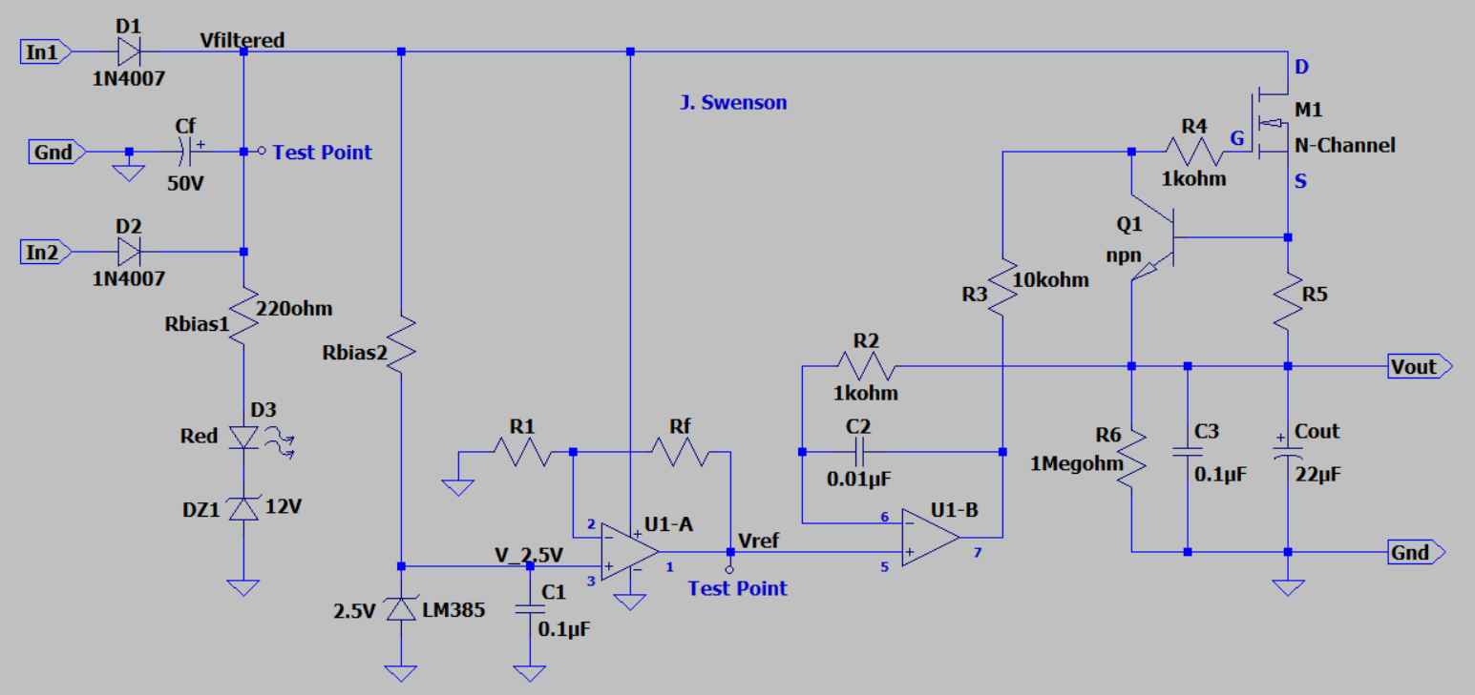
ECEN 350 - DC Power Supply Project

Slide 9
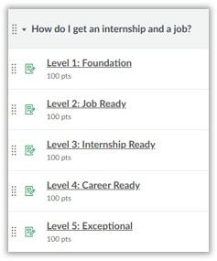
Internship and Job Preparation
To aid in your landing an internship and a job, the following Canvas course titled 'CSE Majors’ has been developed to help your progress through various levels of rediness:
at: https://byui.instructure.com/courses/48558/modules.
The levels correspond to where you should be based on your year in school
(i.e., you should be at Level 1 your freshman year, Level 2 your sophomore year,
and so forth). You will not be graded on the completion of levels and tasks in
this course, but it is in your best interest to make steady progress.
This course encourages the development of a Portfolio, in addition to a Resume.
Portfolios include Presentations and Projects that you have completed that distinguishes you from other applicants.
Your Power Supply Project Report to be submitted at the end of this semester for this course would be a good item to add to your Portfolio, assuming you do good quality work on that project and the accompanying report.

Slide 10
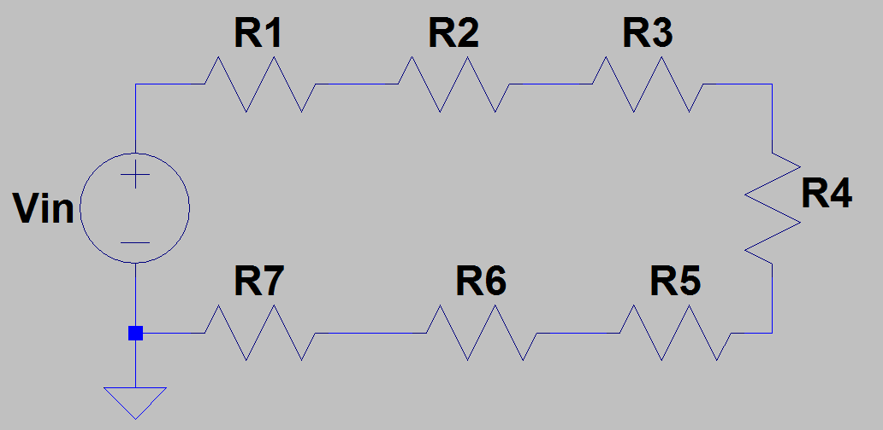
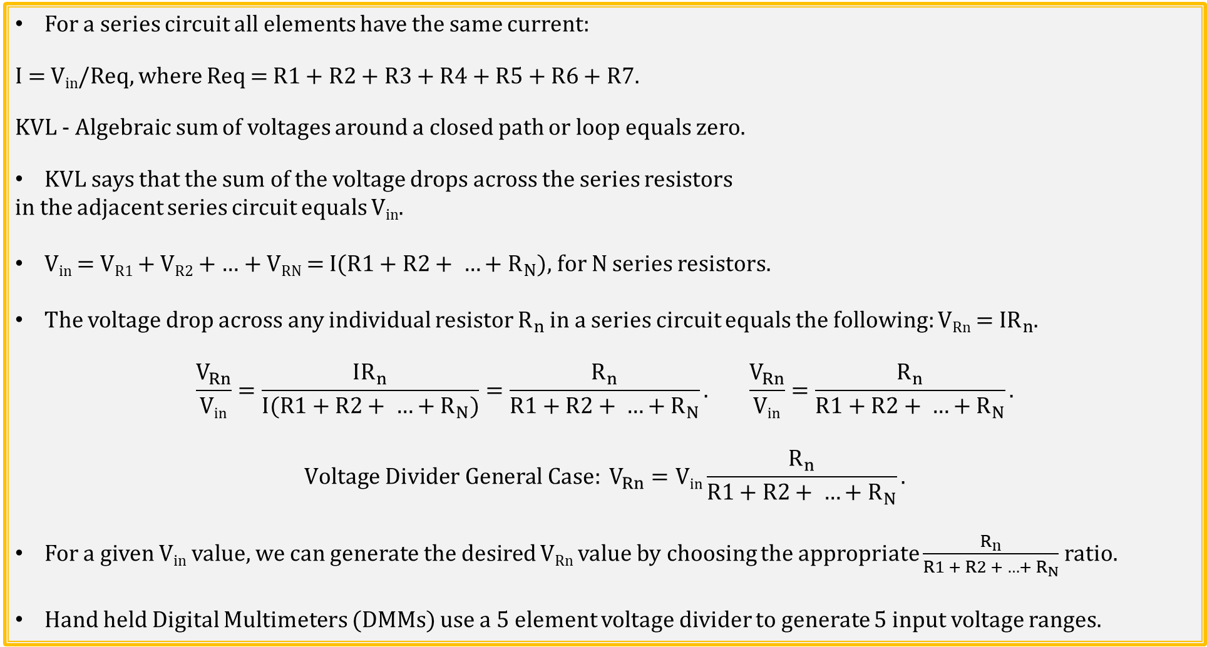
Voltage Divider → General Case
For a series circuit all elements have the same current:
I = V_{in}/Req, where Req = R1 + R2 + R3 + R4 + R5 + R6 + R7.
KVL - Algebraic sum of voltages around a closed path or loop equals zero.
KVL says that the sum of the voltage drops across the series resistors
in the adjacent series circuit equals V_{in}.
V_{in} = V_{R1} + V_{R2} + … + V_{RN} = I($R1+R2+ …+R_{N}$), for N series resistors.
The voltage drop across any individual resistor $R_{n}$ in a series circuit equals the following: V_{Rn} = I$R_{n}$.
$$\frac{V_{Rn}}{\text{V}\text{in}}=\frac{IR_{n}}{I(R1+R2+ …+R_{N})}=\frac{R_{n}}{R1+R2+ …+R_{N}}. \frac{V_{Rn}}{\text{V}\text{in}}=\frac{R_{n}}{R1+R2+ …+R_{N}}.$$
$$Voltage Divider General Case: V_{Rn}=\text{V}\text{in}\frac{R_{n}}{R1+R2+ …+R_{N}}.$$
For a given V_{in} value, we can generate the desired V_{Rn} value by choosing the appropriate $\frac{R_{n}}{R1 + R2 + …+ R_{N}}$ ratio.
Hand held Digital Multimeters (DMMs) use a 5 element voltage divider to generate 5 input voltage ranges.
Notes:
Image by instructor

Slide 11
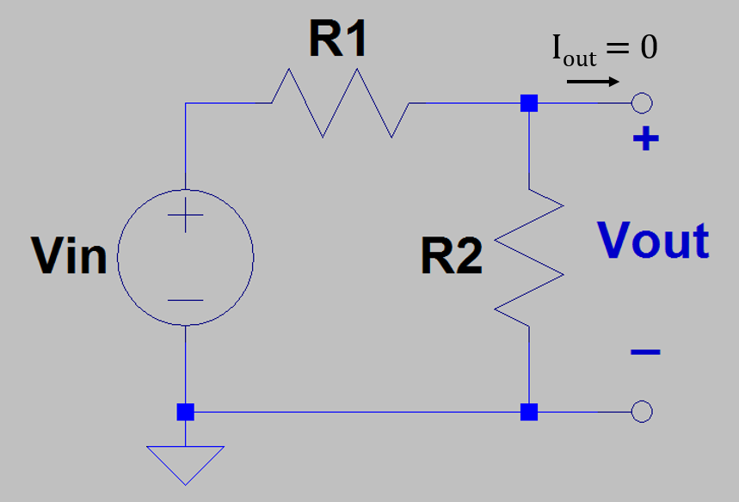
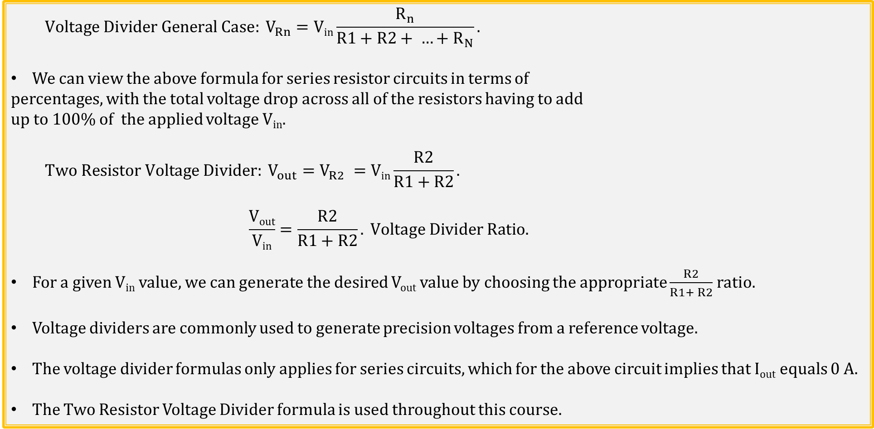
Voltage Divider → Two Resistors
$$Voltage Divider General Case: V_{Rn}=\text{V}\text{in}\frac{R_{n}}{R1+R2+ …+R_{N}}.$$
We can view the above formula for series resistor circuits in terms of
percentages, with the total voltage drop across all of the resistors having to add
up to 100% of the applied voltage V_{in}.
$$Two Resistor Voltage Divider: V_{out}=V_{R2} =\text{V}\text{in}\frac{R2}{R1+R2}.$$
$$\frac{\text{V}\text{out}}{\text{V}\text{in}}=\frac{R2}{R1+R2}. Voltage Divider Ratio.$$
For a given V_{in} value, we can generate the desired V_{out} value by choosing the appropriate $\frac{R2}{R1+ R2}$ ratio.
Voltage dividers are commonly used to generate precision voltages from a reference voltage.
The voltage divider formulas only applies for series circuits, which for the above circuit implies that I_{out} equals 0 A.
The Two Resistor Voltage Divider formula is used throughout this course.
Notes:
Image by instructor

Slide 12
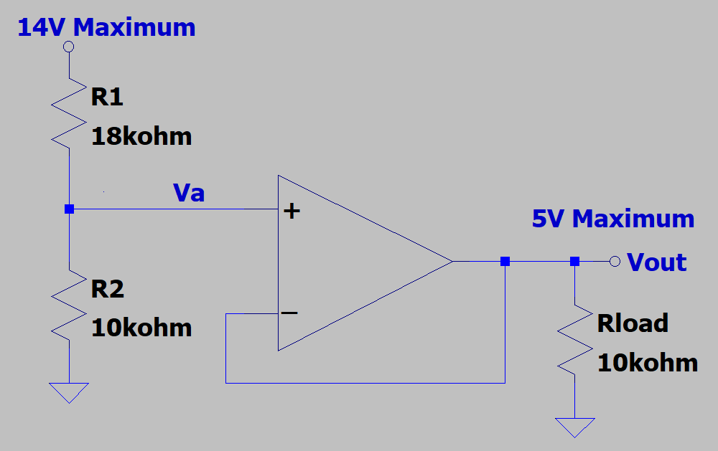
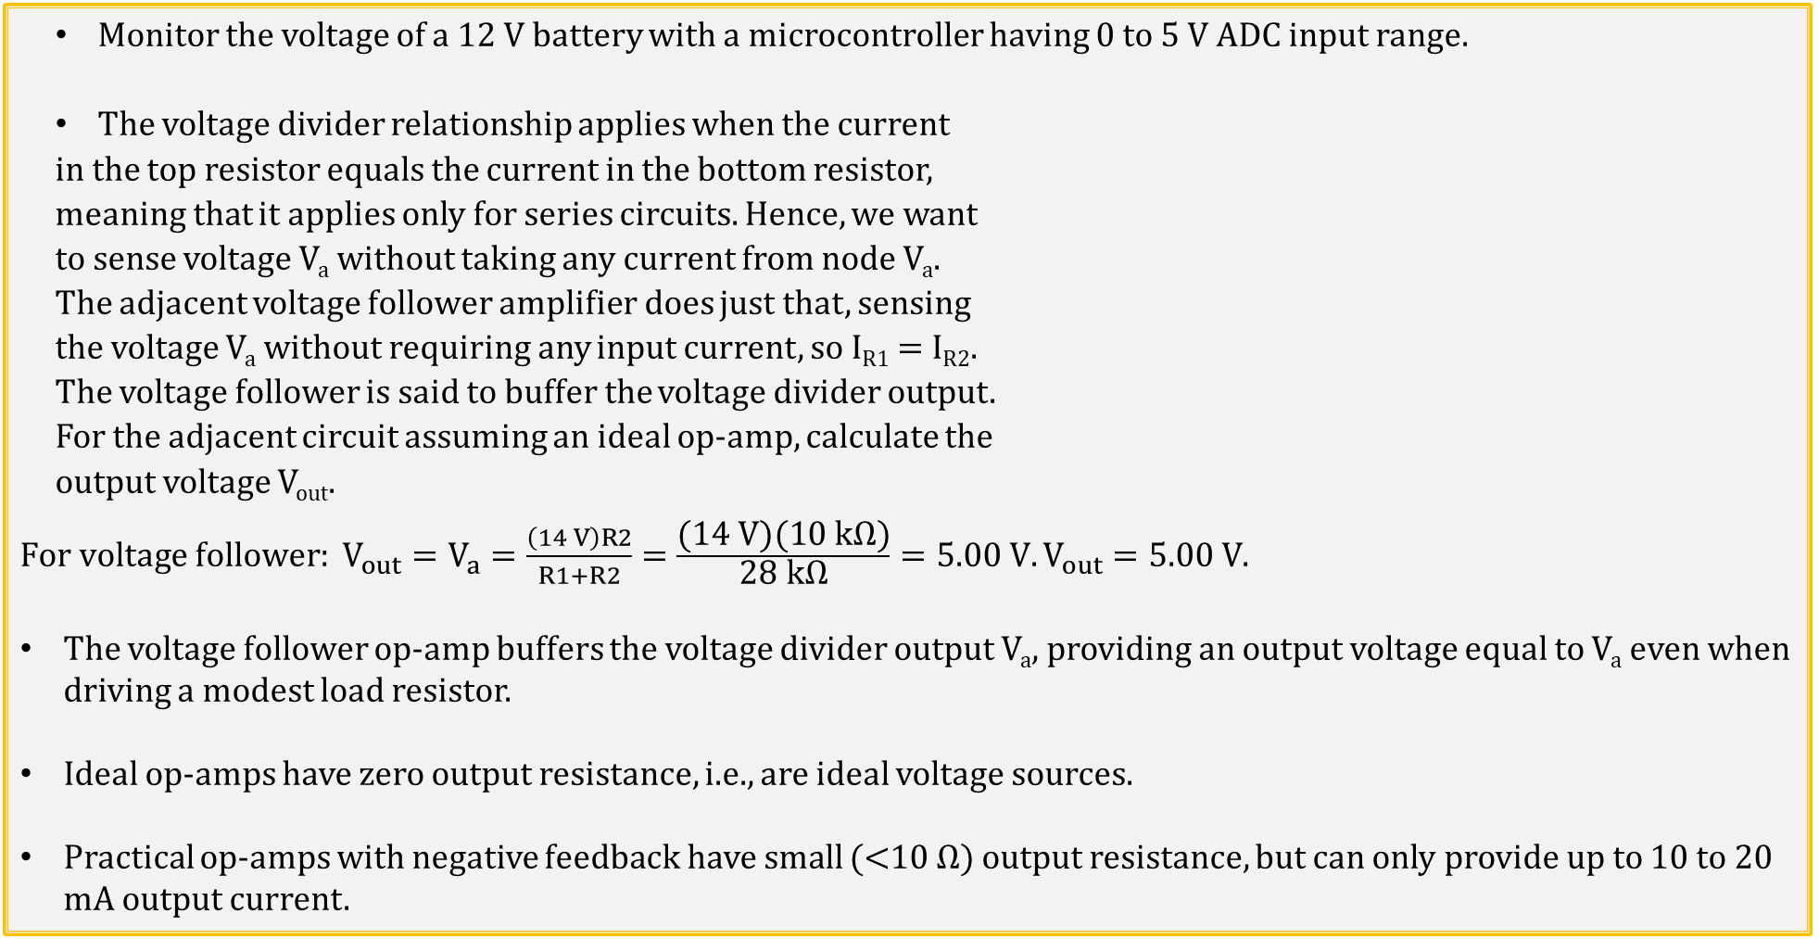
Voltage Divider and Follower Application
Monitor the voltage of a 12 V battery with a microcontroller having 0 to 5 V ADC input range.
The voltage divider relationship applies when the current
in the top resistor equals the current in the bottom resistor,
meaning that it applies only for series circuits. Hence, we want
to sense voltage V_{a} without taking any current from node V_{a}.
The adjacent voltage follower amplifier does just that, sensing
the voltage V_{a} without requiring any input current, so I_{R1} = I_{R2}.
The voltage follower is said to buffer the voltage divider output.
For the adjacent circuit assuming an ideal op-amp, calculate the
output voltage V_{out}.
$For voltage follower: V_{out}=V_{a}=\frac{\left(14 V\right)R2}{R1+R2}=\frac{\text{(}\text{14} \text{V}\text{)(10 }\text{k}\text{Ω)}}{\text{28} \text{k}\text{Ω}}=5.00 V.V_{out}=5.00 V$.
The voltage follower op-amp buffers the voltage divider output V_{a}, providing an output voltage equal to V_{a} even when driving a modest load resistor.
Ideal op-amps have zero output resistance, i.e., are ideal voltage sources.
Practical op-amps with negative feedback have small (<10 Ω) output resistance, but can only provide up to 10 to 20 mA output current.

Slide 13
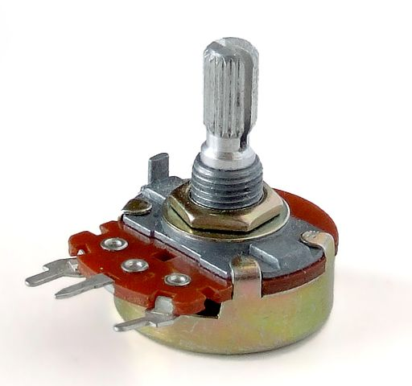
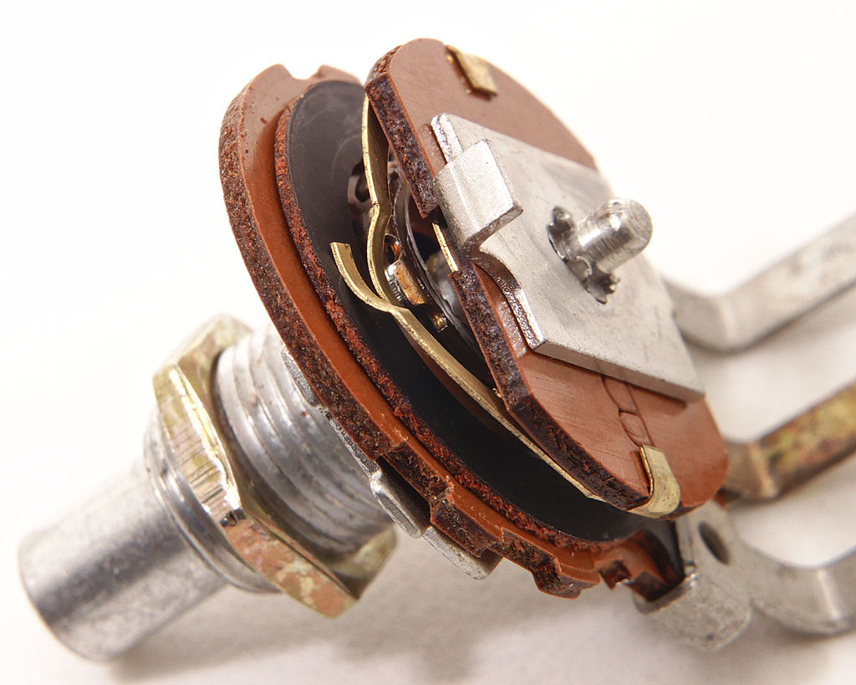
Potentiometer – Adjustable Voltage Divider
Circuit Symbol
Wiper Terminal
This device is referred to as a Trim Pot,
i.e., Trim Potentiometer.
Notes:
https://commons.wikimedia.org/wiki/File%3ASingle-turn_potentiometer_with_internals_exposed%2C_oblique_view.jpg
https://commons.wikimedia.org/wiki/File%3APotentiometer.jpg

Slide 14
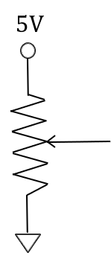
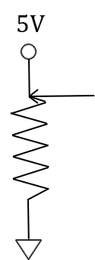
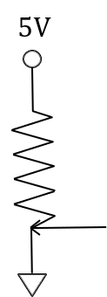


Potentiometer – Adjustable Voltage Divider
R_{top}
R_{pot}
V_{wiper} = $\frac{\left(5 V\right)R_{bot}}{R_{top}+{ R}_{bot}}$. $R_{top}+{ R}_{bot}$ = R_{pot} . V_{wiper} = $\frac{\left(5 V\right)R_{bot}}{R_{pot}}$. If R_{bot} = R_{top}, then V_{wiper} = 2.5 V.
R_{bot}
$R_{top}$= $0 Ω$. V_{wiper_max} = $\frac{\left(5 V\right)R_{bot_max}}{R_{pot}}$ = $\frac{\left(5 V\right)R_{pot}}{R_{pot}}$ = 5 V.
R_{pot}
R_{pot}
$R_{bot}$= $0 Ω$. V_{wiper_min} = $\frac{\left(5 V\right)R_{bot_min}}{R_{pot}}$ = $\frac{\left(5 V\right)(0 Ω)}{R_{pot}}$ = 0 V.

Slide 15
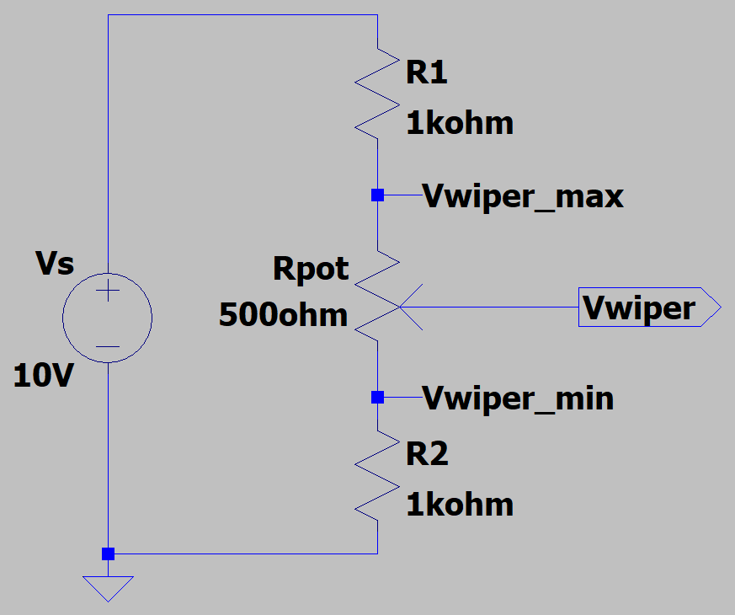
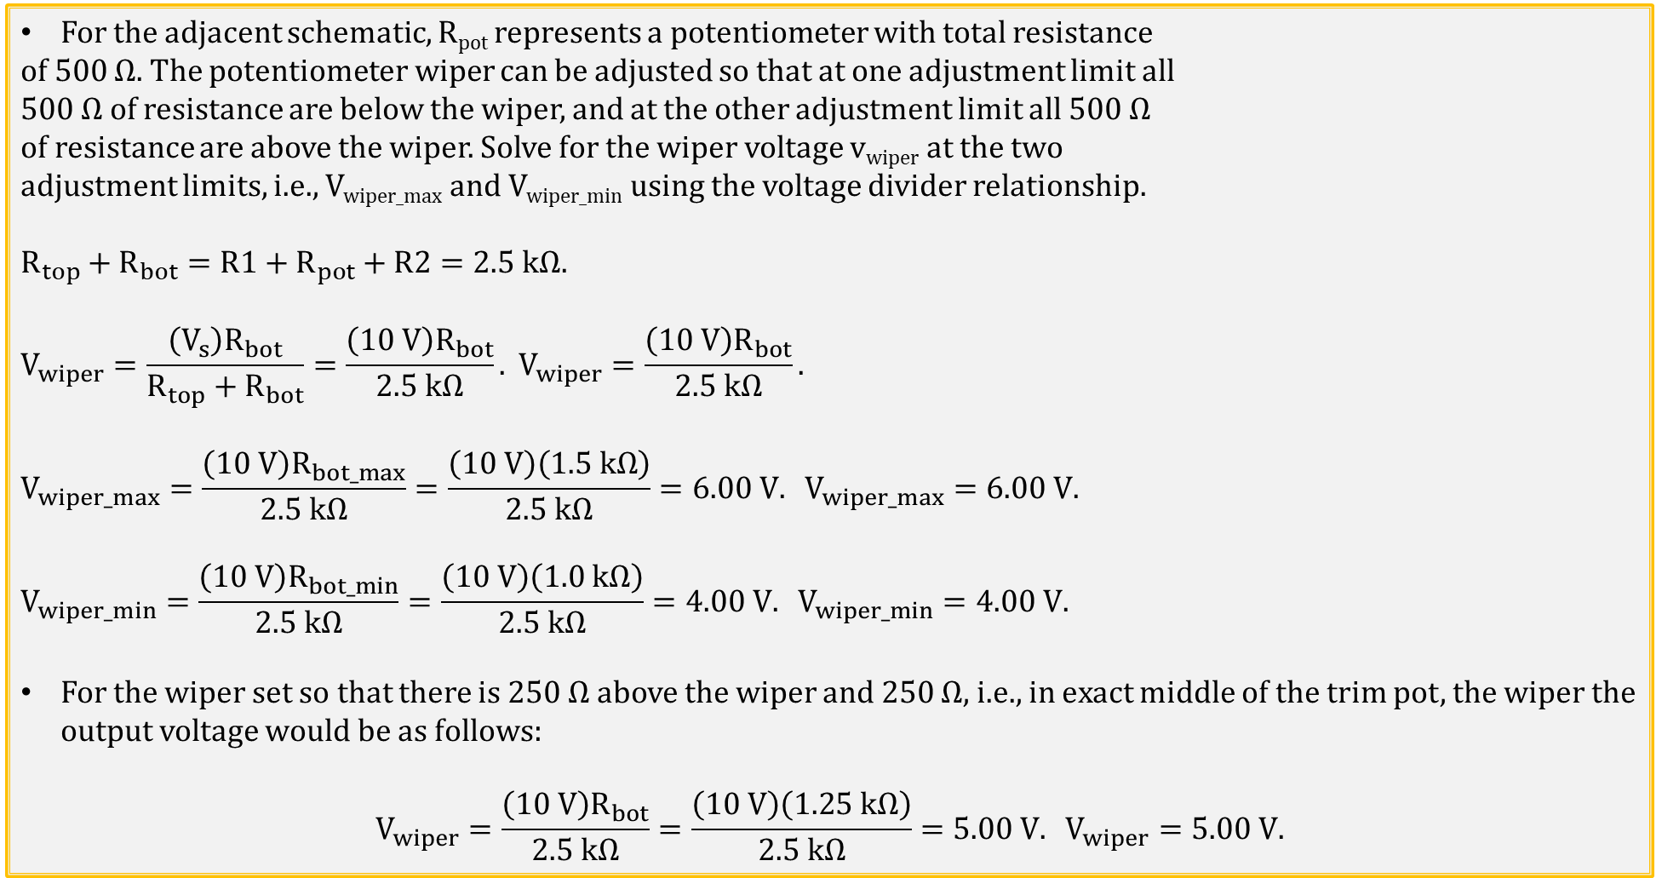
Potentiometer Example
For the adjacent schematic, R_{pot} represents a potentiometer with total resistance
of 500 Ω. The potentiometer wiper can be adjusted so that at one adjustment limit all
500 Ω of resistance are below the wiper, and at the other adjustment limit all 500 Ω
of resistance are above the wiper. Solve for the wiper voltage v_{wiper} at the two
adjustment limits, i.e., V_{wiper_max} and V_{wiper_min} using the voltage divider relationship.
$$R_{top}+R_{bot}=R1+R_{pot}+R2=2.5 kΩ.$$
$$V_{wiper}=\frac{\left(V_{s}\right)R_{bot}}{R_{top}+R_{bot}}=\frac{\left(10 V\right)R_{bot}}{2.5 kΩ}. V_{wiper}=\frac{\left(10 V\right)R_{bot}}{2.5 kΩ}.$$
$$V_{wiper_max}=\frac{\left(10 V\right)R_{bot_max}}{2.5 kΩ}=\frac{\left(10 V\right)\left(1.5 kΩ\right)}{2.5 kΩ}=6.00 V. V_{wiper_max}=6.00 V.$$
$$V_{wiper_min}=\frac{\left(10 V\right)R_{bot_min}}{2.5 kΩ}=\frac{\left(10 V\right)\left(1.0 kΩ\right)}{2.5 kΩ}=4.00 V. V_{wiper_min}=4.00 V.$$
For the wiper set so that there is 250 Ω above the wiper and 250 Ω, i.e., in exact middle of the trim pot, the wiper the output voltage would be as follows:
$$V_{wiper}=\frac{\left(10 V\right)R_{bot}}{2.5 kΩ}=\frac{\left(10 V\right)\left(1.25 kΩ\right)}{2.5 kΩ}=5.00 V. V_{wiper}=5.00 V.$$

Slide 16
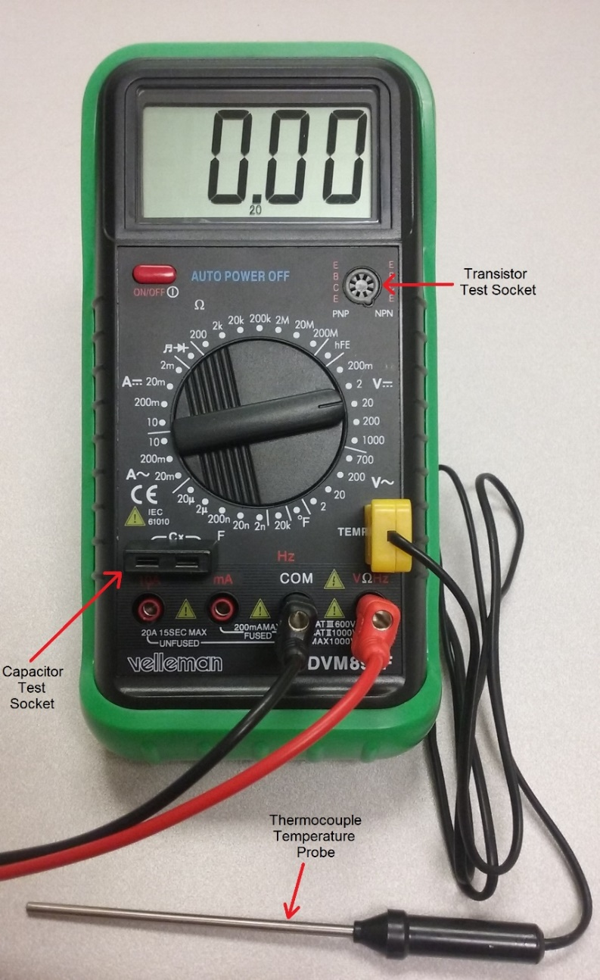
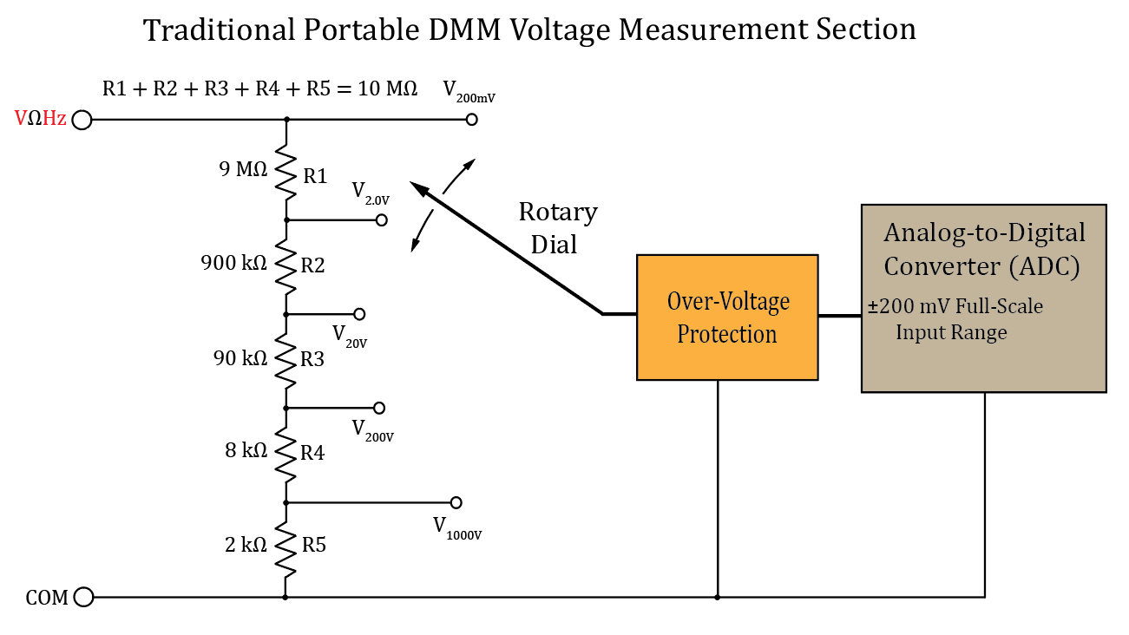
Digital Multi-Meter → DMM
Hand held DMMs use a 5 element voltage divider to generate 5 input voltage ranges.
While this is an inexpensive way to arrive at 5 different voltage ranges, it results in an input resistance/impedance of 10 MΩ.
Consequently, when measuring a 10 V DC input, the DMM takes (10 V)/(10 M Ω) = 1 µA from the circuit.
While this is not noticeable for most circuits, it becomes noticeable for high-resistance, i.e., low-current circuits.
Notes:
Image by instructor

Slide 17
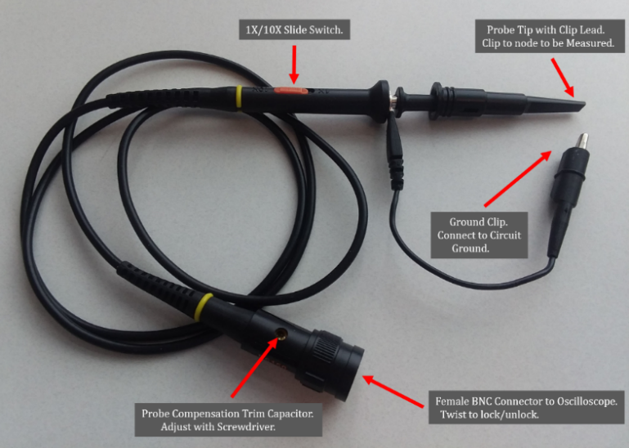
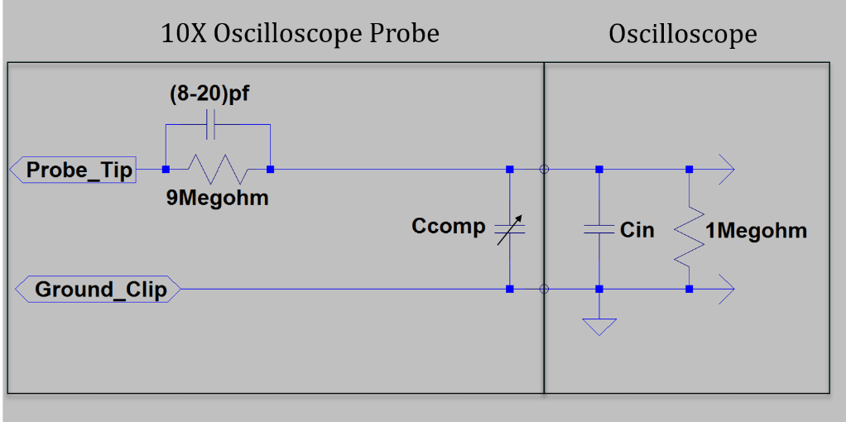
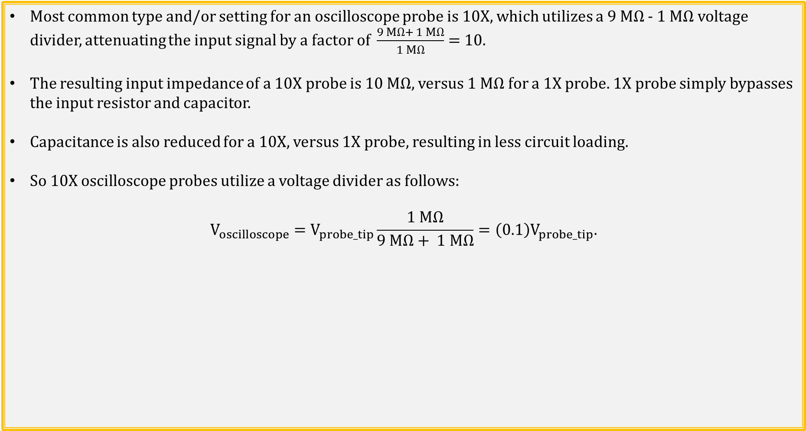
10X and 1X Oscilloscope Probes
Most common type and/or setting for an oscilloscope probe is 10X, which utilizes a 9 MΩ - 1 MΩ voltage divider, attenuating the input signal by a factor of $\frac{9 MΩ+ 1 MΩ}{1 MΩ}=$10.
The resulting input impedance of a 10X probe is 10 MΩ, versus 1 MΩ for a 1X probe. 1X probe simply bypasses the input resistor and capacitor.
Capacitance is also reduced for a 10X, versus 1X probe, resulting in less circuit loading.
So 10X oscilloscope probes utilize a voltage divider as follows:
$$V_{oscilloscope}=V_{probe_tip}\frac{1 MΩ}{9 MΩ+ 1 MΩ}=\left(0.1\right)V_{probe_tip}.$$
Notes:
Image by instructor

Slide 18
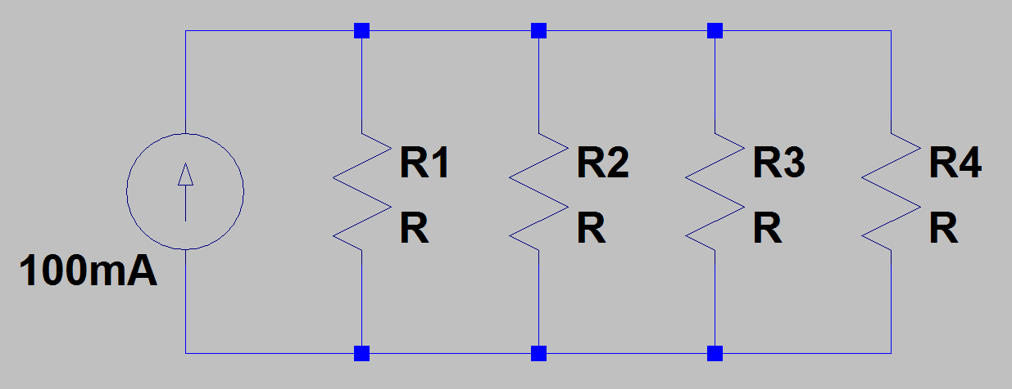
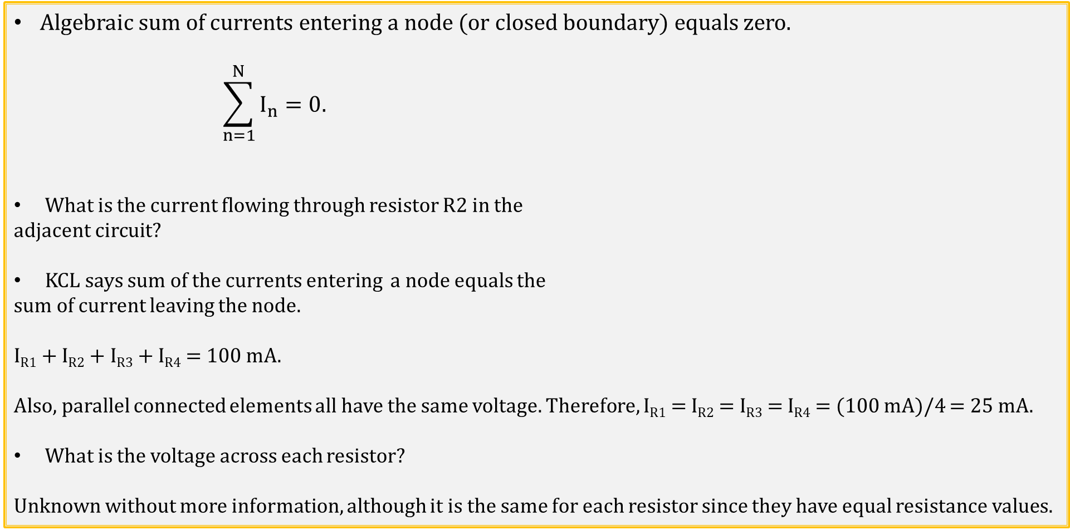
Kirchhoff’s Current Law (KCL)
Algebraic sum of currents entering a node (or closed boundary) equals zero.
$$\sum_{n=1}^{N}{I_{n}=0.}$$
What is the current flowing through resistor R2 in the
adjacent circuit?
KCL says sum of the currents entering a node equals the
sum of current leaving the node.
I_{R1} + I_{R2} + I_{R3} + I_{R4} = 100 mA.
Also, parallel connected elements all have the same voltage. Therefore, I_{R1} = I_{R2} = I_{R3} = I_{R4} = (100 mA)/4 = 25 mA.
What is the voltage across each resistor?
Unknown without more information, although it is the same for each resistor since they have equal resistance values.
Notes:
Image by instructor

Slide 19
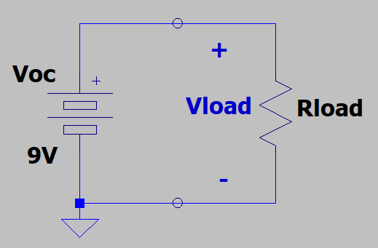
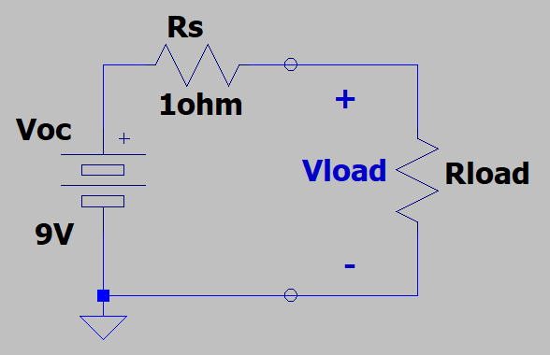
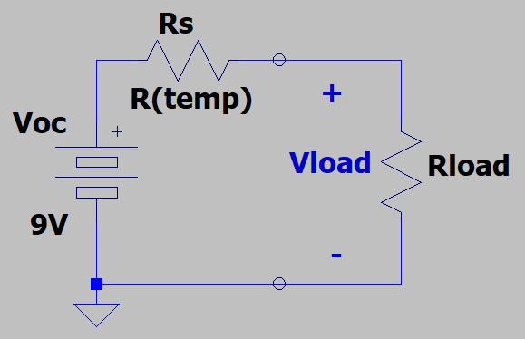
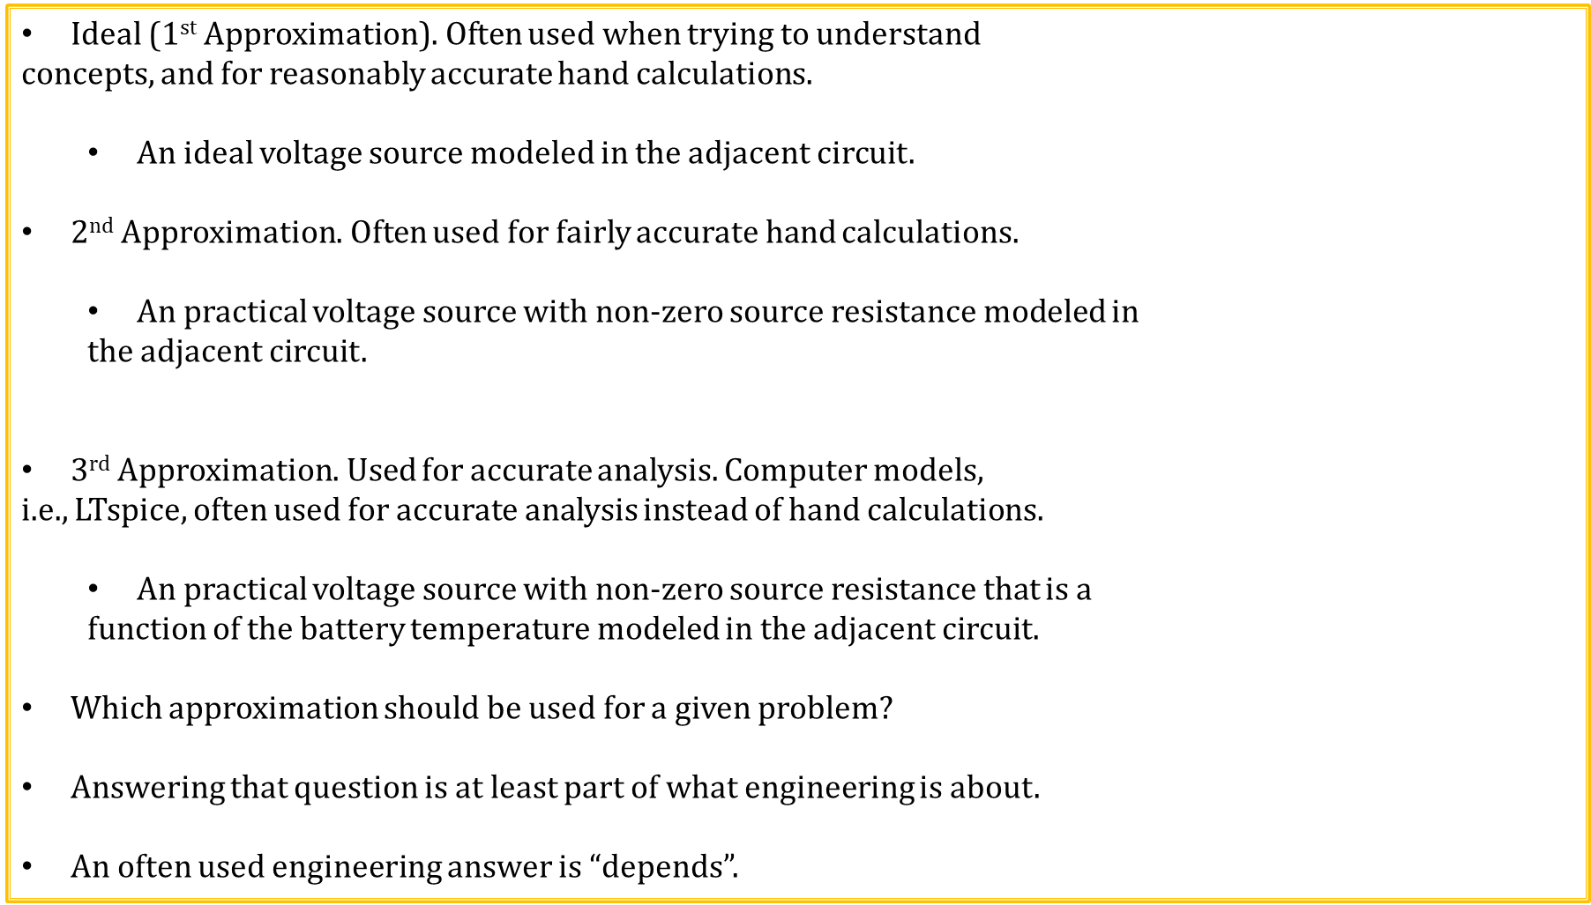
Approximations
Ideal (1st Approximation)$.$ Often used when trying to understand
concepts, and for reasonably accurate hand calculations.
An ideal voltage source modeled in the adjacent circuit.
2nd Approximation$.$ Often used for fairly accurate hand calculations.
An practical voltage source with non-zero source resistance modeled in
the adjacent circuit.
3rd Approximation$.$ Used for accurate analysis. Computer models,
i.e., LTspice, often used for accurate analysis instead of hand calculations.
An practical voltage source with non-zero source resistance that is a
function of the battery temperature modeled in the adjacent circuit.
Which approximation should be used for a given problem?
Answering that question is at least part of what engineering is about.
An often used engineering answer is “depends”.

Slide 20
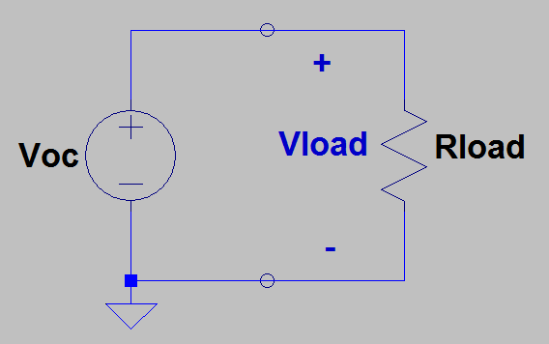
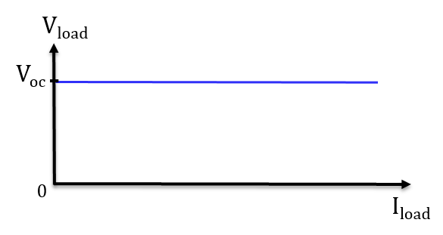
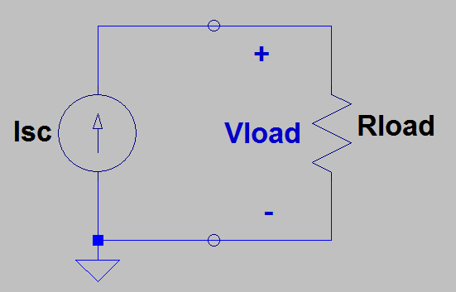
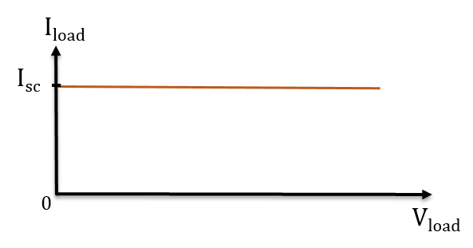
Voltage and Current Sources
An ideal voltage source provides the desired voltage no matter how much current is required.
Hence, an ideal voltage source is independent of load current.
An ideal current source provides the desired current no matter how much voltage is required.
Hence, an ideal current source is independent of load voltage.

Slide 21
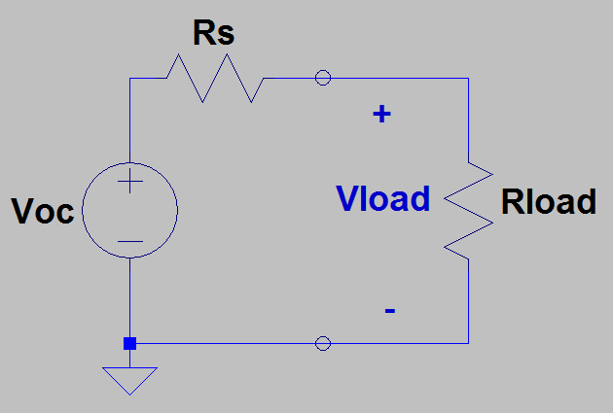
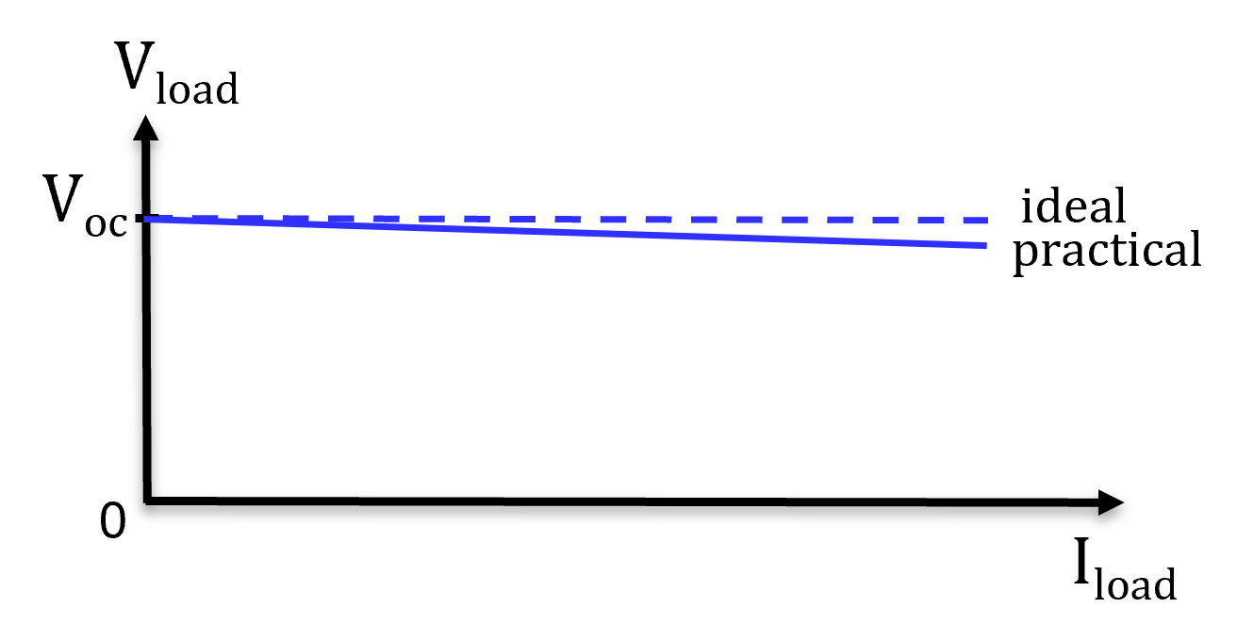
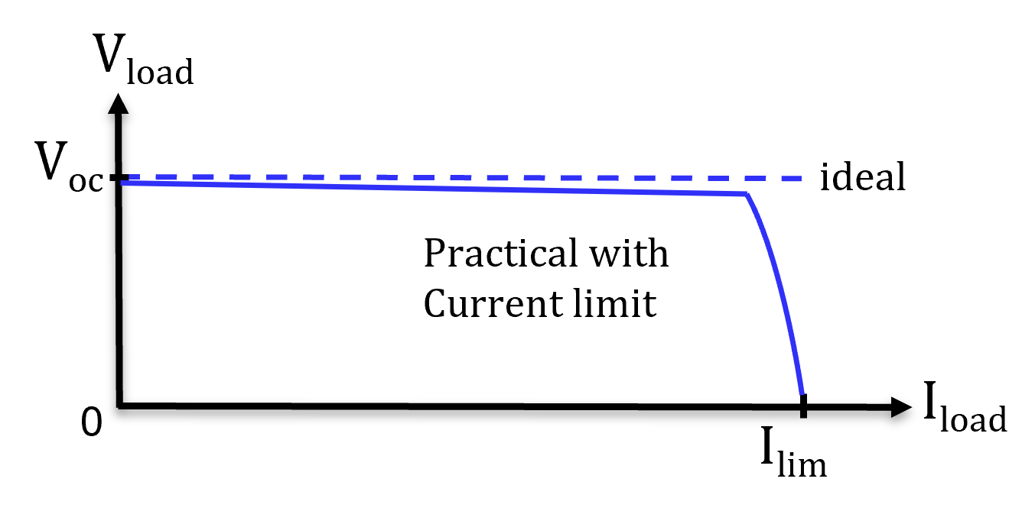
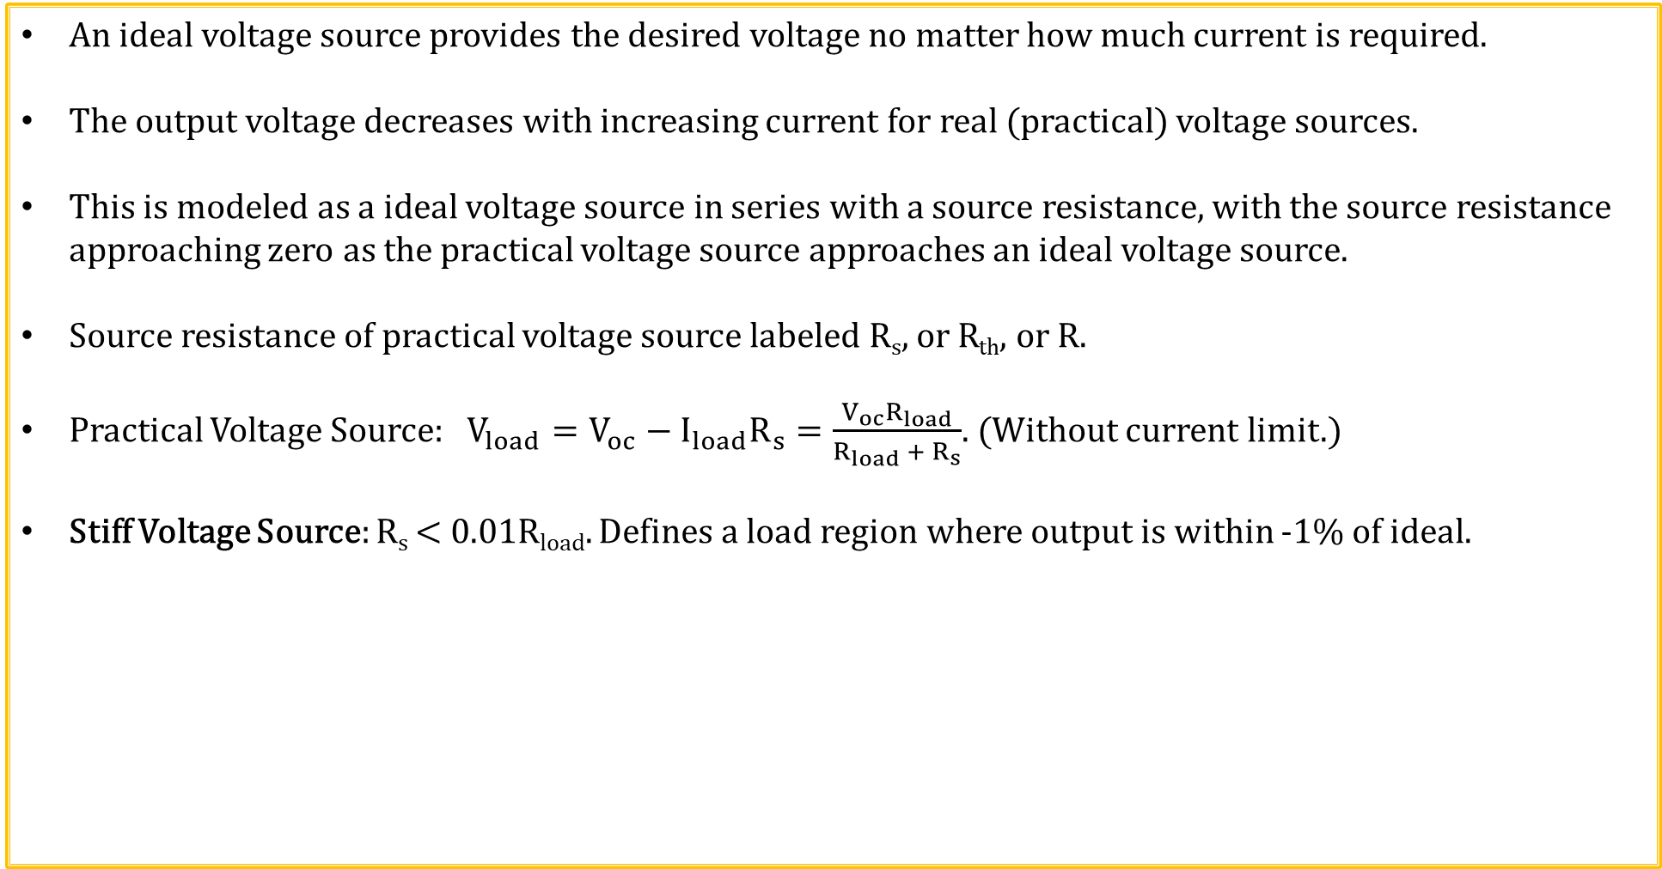
Practical Voltage Sources
An ideal voltage source provides the desired voltage no matter how much current is required.
The output voltage decreases with increasing current for real (practical) voltage sources.
This is modeled as a ideal voltage source in series with a source resistance, with the source resistance approaching zero as the practical voltage source approaches an ideal voltage source.
Source resistance of practical voltage source labeled R_{s}, or R_{th}, or R.
Practical Voltage Source: $V_{load}=V_{oc}−I_{load}R_{s}=\frac{V_{oc}R_{load}}{R_{load} +{ R}_{s}}$. (Without current limit.)
Stiff Voltage Source: R_{s} < 0.01R_{load}. Defines a load region where output is within -1% of ideal.

Slide 22
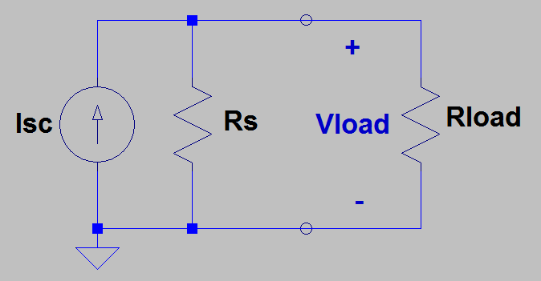
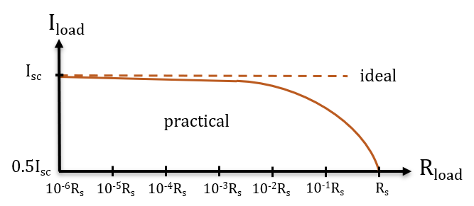
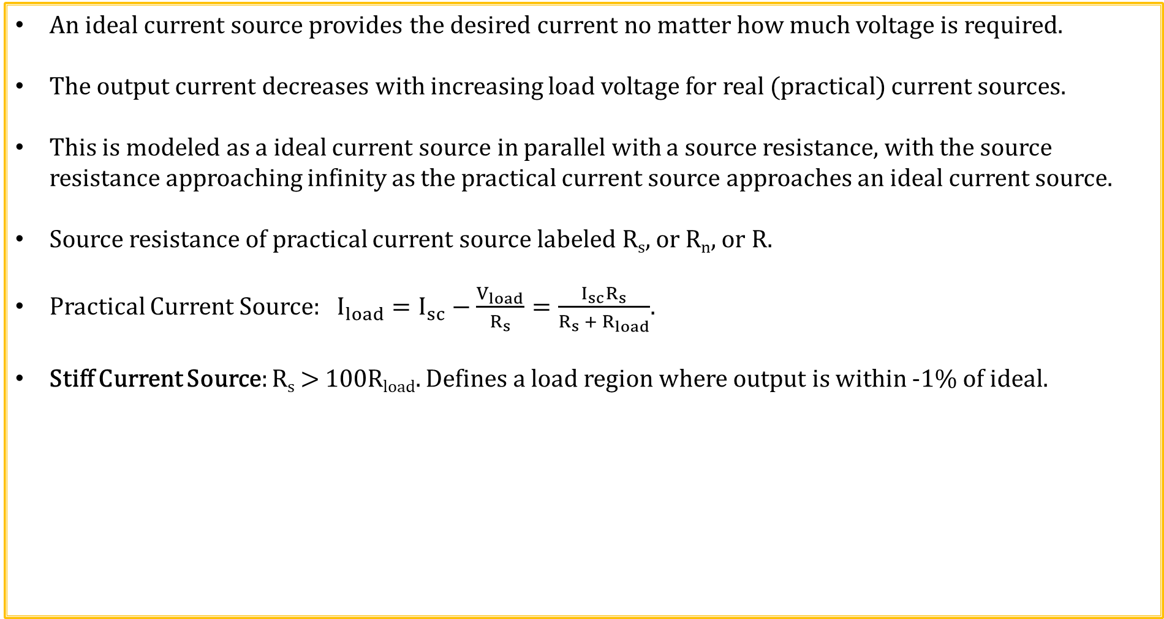
Practical Current Sources
An ideal current source provides the desired current no matter how much voltage is required.
The output current decreases with increasing load voltage for real (practical) current sources.
This is modeled as a ideal current source in parallel with a source resistance, with the source resistance approaching infinity as the practical current source approaches an ideal current source.
Source resistance of practical current source labeled R_{s}, or R_{n}, or R.
Practical Current Source: $I_{load}=I_{sc}−\frac{V_{load}}{R_{s}}=\frac{I_{sc}R_{s}}{R_{s} +{ R}_{load}}$.
Stiff Current Source: R_{s} > 100R_{load}. Defines a load region where output is within -1% of ideal.

Slide 23
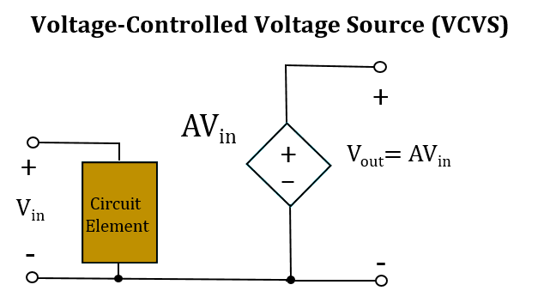
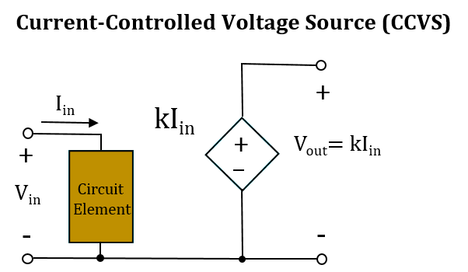
Dependent Voltage Sources
Op-Amp Model

Slide 24
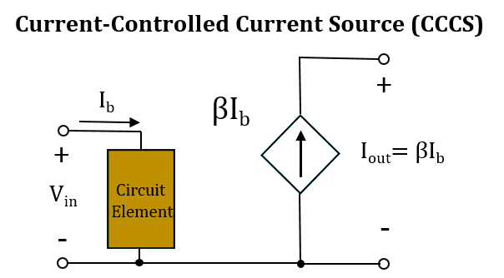
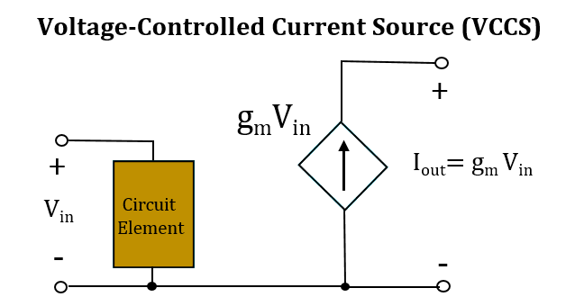
Dependent Current Sources
Bipolar Junction Transistor Model
MOS Transistor Model

Slide 25
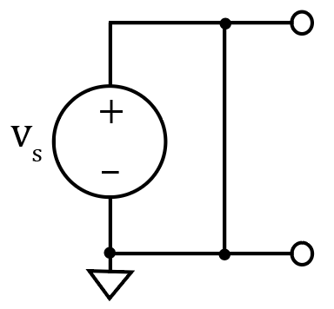
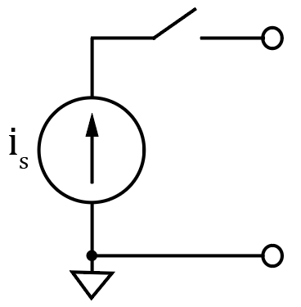
Superposition Principle
The voltage across or current through an element in a linear circuit is the algebraic sum of the voltages across or the currents through that element due to each independent source acting alone. (Additivity property of linear systems).
Good way to solve systems with both AC and DC sources, such as audio amplifiers.
Consider each independent source separately, then algebraically sum the results together.
To consider each independent source separately, independent sources not being considered must be turned off.
How do you turn off a voltage source?
Set it equal to zero. Can short across it for schematics to achieve 0 V,
but don’t do this for real circuits.
How do you turn off a current source?
Simply remove it, i.e., open circuit it from the circuit, because a current
source with zero current provides 0 A at all possible voltages, which is
achieved with an open circuit.

Slide 26
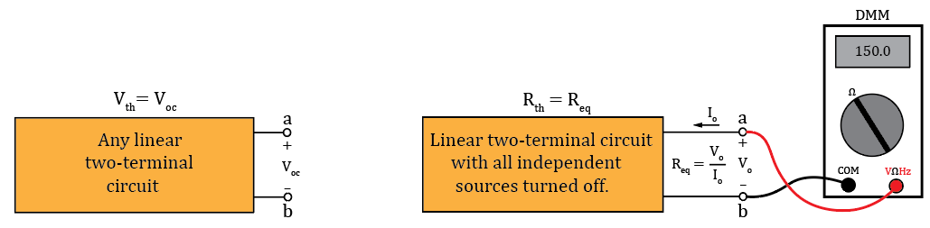
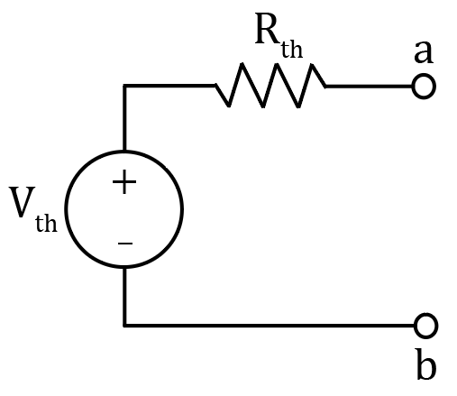
Thevenin’s Theorem
Sometimes, we only care about what happens at the output terminals of a given circuit when connected to some load. Thevenin’s and Norton’s Theorems provide simplified equivalent circuits for any linear circuit having two output terminals.
Thevenin’s Theorem: Any linear two-terminal circuit can be replaced by a voltage source (V_{th}) in series with a resistance (R_{th}). The voltage source (V_{th}) is the open-circuit voltage at the output terminals and the resistance (R_{th}) is the equivalent resistance between the output terminals with all independent sources turned off.
A Thevenin’s Equivalent circuit is a practical voltage source.
The resulting Thevenin’s equivalent circuit provides equivalent
performance as the original circuit with regards to an external loads.
Thevenin’s Theorem Diagrams
Notes:
Image by instructor

Slide 27
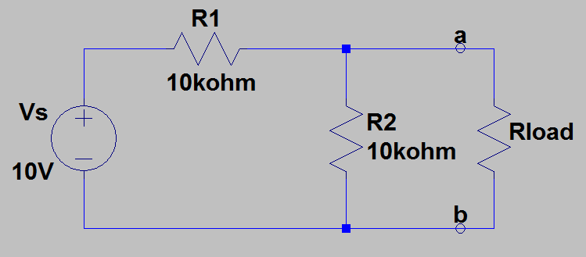
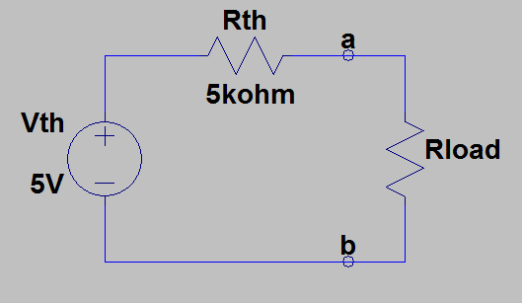
Thevenin’s Theorem Example 1
Find the Thevenin’s equivalent circuit to the left of terminals a and b.
First remove Rload, to open-circuit
terminals a - b to find V_{th} and R_{th}.
V_{th} = V_{ab} = V_{s}R2/(R1 + R2)
V_{th} = (10 V)(10 kΩ)/(20 kΩ) = 5.0 V.
V_{th} = 5.0 V.
R_{th} = R1ǁR2 = (10 kΩ)(10 kΩ)/(20 kΩ) = 5 kΩ.
R_{th} = 5 kΩ.
Now can load output and solve for load
voltages and currents using simplified
Thevenin’s equivalent.
Notes:
Image by instructor

Slide 28
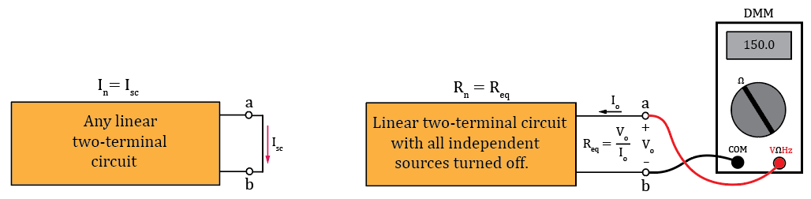
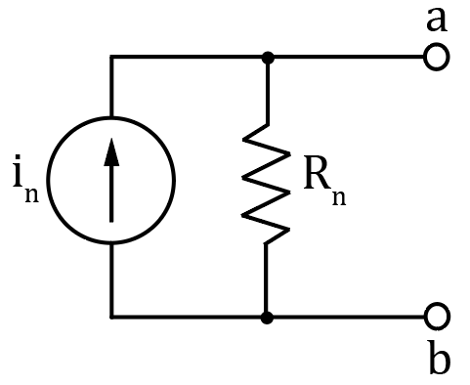
Norton’s Theorem
Any linear two-terminal circuit can be replaced by a current source (I_{n}) in parallel with a resistance (R_{n}). The current source (I_{n}) is the short-circuit current at the output terminals and the resistance (R_{n}) is the equivalent resistance between the output terminals with all independent sources turned off.
The Norton’s Equivalent circuit is a practical current source.
The resulting Norton’s equivalent circuit provides equivalent
performance as the original circuit with regards to an external load.
The Norton resistance R_{n} is equivalent to the Thevenin resistance R_{th}.
Norton’s Theorem Diagrams
Notes:
Image by instructor

Slide 29
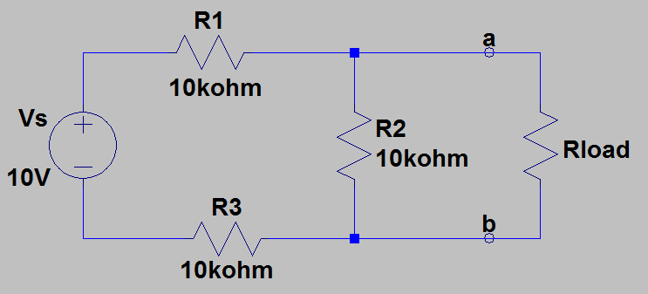

Norton’s Theorem Example 1
Find the Norton’s equivalent circuit
left of terminals a and b.
First short-circuit the a - b terminals
in order to find I_{n}.
I_{n} = V_{s}/(R1 + R3) = (10 V)/(20 kΩ)
I_{n} = 0.5 mA. I_{n} = 0.5 mA.
Next remove the a –b terminal short, set V_{s}= 0, and look into the a – b terminals to determine R_{n}.
R_{n} = (R1 + R3)ǁR2.
R_{n} = (20 kΩ)(10 kΩ)/(20 kΩ + 10 kΩ) = 6.67 kΩ.
R_{n} = 6.67 kΩ.
Now can load output and solve for load voltages
and currents using simplified Norton’s equivalent.
Poll Questions
Notes:
Image by instructor

Slide 30



Alternating Current - AC
Current and voltage have to change polarity (alternate) to be AC signal.

Slide 31



Transformers
Transformer: Magnetic circuit used for stepping AC voltages and currents up or down.
Magnetic flux is contained within high permeability (low reluctance) core.
Changing (AC) primary current produces changing magnetic flux in the transformer core that induces a changing (AC) secondary voltage. Mainstream application of Faraday’s Law.
Why AC and not DC also?
Because changing flux is necessary for electromagnetic induction.
$$V_{p}=−N_{p}\frac{dΦ}{dt}, V_{s}=−N_{s}\frac{dΦ}{dt}, \frac{dΦ}{dt}=\frac{V_{p}}{−N_{p}}=\frac{V_{s}}{−N_{s}}.$$
$$\frac{Secondary Voltage}{Primary Voltage}=\frac{V_{s}}{V_{p}}=\frac{N_{s}}{N_{P}}.$$
$$Ideally, P_{p}=P_{s}. V_{p}I_{p}=V_{s}I_{s}. I_{s}=I_{p}\frac{V_{p}}{V_{s}}=I_{p}\frac{N_{p}}{N_{s}}.$$
$$\frac{Secondary Current}{Primary Current}=\frac{I_{s}}{I_{p}}=\frac{N_{p}}{N_{s}}.$$

Slide 32



Center-Tapped Transformer
Center-tapped transformer has 3 secondary terminals, with the middle terminal often connected to ground.
Connecting the middle secondary terminal to ground results in V_{s1} = -V_{s2}, i.e., each half of the secondary produces equal magnitude but opposite sign sinusoids. So when V_{s1} is positive, V_{s2} is negative and vice versa.
For the above transformer V_{prim}/V_{sec_Total} = N_{prim}/N_{sec_Total}. V_{sec_Total} = V_{prim}N_{sec_Total}/N_{prim} = V_{prim}/N, where N = N_{prim}/N_{sec_Total}.
Because of the grounded center tap, each secondary has a peak value of V_{p_prim}/2N, i.e., V_{p_sec_1} = V_{p_sec_2} = V_{p_prim}/2N.
Grounded center tap results in two equal magnitude, opposite sign sinusoids, having peak amplitudes of V_{p_prim}/2N.
Notes:
BillC at the English language Wikipedia [GFDL (http://www.gnu.org/copyleft/fdl.html) or CC-BY-SA-3.0 (http://creativecommons.org/licenses/by-sa/3.0/)], via Wikimedia Commons

Slide 33


DC Blocking Capacitor
Given that V_{ac} is a high frequency ac signal, what does the output voltage V_{out} equal in the circuit below?
V_{out} = V_{ac}, because capacitors block constant dc voltages.
Can analyze this circuit using Superposition, separating
out the DC and AC supplies.
Oscilloscopes offer ac coupling, meaning that a large value capacitor is placed in series with the input to block constant dc voltages associated with the signal to be measured.

Slide 34




Inductive and Capacitive Reactance
$$For an inductor, impedance Z_{L}=jωL=j2πfL=jX_{L}.$$
$Inductive reactance: X_{L}=2πfL$.
|$Z_{L}\left(f\right)\text{|} is 0 Ω at 0 Hz and increases with increasing frequency.$
$$For a capacitor, impedance Z_{C}=\frac{1}{jωC}=\frac{1}{j2πfC}=\frac{−j}{2πfC}=−jX_{C}.$$
Capacitive Reactance: $X_{C}=\frac{1}{2πfC}$.
$\text{|}Z_{C}\left(f\right)\text{|} is ∞ Ω at 0 Hz and decreases with$
$$increasing frequency.$$

Slide 35
Superposition Principle
The voltage across or current through an element in a linear circuit is the algebraic sum of the voltages across or the currents through that element due to each independent source acting alone. (Additivity property of linear systems).
Good way to solve systems with multiple sources.
Consider each independent source separately, then algebraically sum the results together.
To consider each independent source separately, independent sources not being considered must be turned off.
Dependent sources are left intact because they are controlled by circuit variables.
How do you turn off a voltage source?
Set it equal to zero. Can short across it for schematics to achieve 0 V, but don’t do this for real circuits.
How do you turn off a current source?
Simply remove it from the circuit, because a current source with zero current provides 0 A at all possible voltages, which is achieved with an open circuit.

Slide 36


Linearity
Formally, linear circuits posses two properties:
1. Homogeneity (scaling): Doubling the input doubles the output (Constant slope).
2. Additivity: Total response to multiple inputs equals sum of the response to
individual inputs applied separately.
For linear circuit elements, doubling the voltage doubles the current
(homogeneity). but not necessarily so for non-linear elements.
Diodes are examples of non-linear devices,
i.e., the slope of voltage-current relationship changes
with the applied voltage.
Non-linear devices like diodes are quite useful in circuits,
yet harder to analyze because they are not linear circuit elements.

Slide 37

Linearity (Continued)
Why doesn’t homogeneity and additivity apply to non-linear systems?
Because as shown for the diode i-v characteristics, homogeneity (scaling) definitely doesn’t hold true in general. Additivity is similar. Could have two DC voltages applies separately that result in almost zero diode current,
yet when added together the resulting diode current could be much greater than that with separately applied voltages.
Superposition principle founded upon the additivity property of linear systems.

Slide 38
The End

Slide 39
Extra

Slide 40


Simplified 741 IC Op-Amp Schematic
741 op-amp utilizes bipolar junction transistors, resistors, diodes and a
capacitor, all integrated into one silicon chip or IC, and costing less that $1.00.
Op-amp assumptions for Hand Calculations: (Technical Interviews.)
1. Infinite open-loop voltage gain. What is open-loop gain?
2. Infinite input resistance, meaning the current into the minus and plus input terminals equals 0 A.
3. Zero output resistance, which is the assumption made for an ideal voltage source.
An additional ideal op-amp assumption is that when negative feedback is incorporated we assume that the voltage difference between the inverting (minus -) and non-inverting (plus +) inputs equals 0 V.
Why can we assume the voltage difference between the minus and plus inputs is zero with negative feedback?
Many op-amps have a dc open-loop gain ≥ 50,000. Because of large open-loop voltage gain and negative feedback, V_{out} is always adjusting the minus input towards the plus input.

Slide 41

Ideal Voltage Follower
What is V_{out} and why in the adjacent circuit?
V_{p} = V_{m}. Also, V_{p} = V_{in}. Therefore V_{out} = V_{in}. V_{out} is said to follow V_{in}.
Why does V_{p} = V_{m}?
Because of large open-loop voltage gain and negative feedback, V_{out} is always adjusting V_{m} towards V_{p}.
If V_{out} became < V_{in}, then V_{p} > V_{m}, resulting in V_{out} increasing until V_{m} again equals V_{p}.
If V_{out} became > V_{in}, then V_{p} < V_{m}, resulting in V_{out} decreasing until V_{m} again equals V_{p}.
The only time that V_{out} is not adjusting V_{m} towards V_{p}, is when V_{m} = V_{p}, which implies V_{out} = V_{in}. Hence, V_{out} follows V_{in}.
The further away V_{m} is from V_{p}, the more forcefully V_{out} adjusts V_{m} towards V_{p}.
The closer V_{m} is to V_{p}, the less forcefully V_{out} adjusts V_{m} towards V_{p}.
Since V_{out} = V_{in}, the resulting voltage gain with feedback, i.e., closed-loop gain = 1 because of negative feedback, whereas open-loop gain >> 1.

Slide 42

Feedback Control
Feedback control: Inverted Pendelum
Feedback control is used to keep the bottom (-) end of the pendulum in vertical alignment with the top (+) end, with the controller constantly minimizing any difference. As a result, the bottom (-) end follows the vertical position of the top (+) end of the inverted pendulum. The horizontal corrective response of the controller has to be larger than any misalignment to keep the pendelum inverted, making large horizontal gain and quick response time desirable. The larger the vertical mis-alignment, the larger the corrective response to minimize the misallignment.
Feedback control: Voltage Follower
Feedback control is used to keep the minus (-) input of the op-amp equal to the plus (+) input, with the op-amp output constantly minimizing any difference. As a result, the minus (-) input follows the voltage of the plus (+) input of the op-amp when the output is connected to the minus (-) input, referred to as negative feedback. The corrective response of the op-amp has to be larger than any |v_{p} - v_{m}|, for the output to follow the input, making large open-loop voltage gain and quick response time desirable. The larger the magnitude of v_{p} - v_{m},, i.e., |v_{p} - v_{m}|, the larger the corrective response to minimize |v_{p} - v_{m}|.

Slide 43
Simplified 741 IC Op-Amp Schematic
741 op-amp utilizes bipolar junction transistors, resistors,
diodes and a capacitor, all integrated into one silicon chip or IC, and
costing less that $1.00 in quantity.
IC op-amps are ubiquitous in modern circuit designs.
Op-amps are used for signal conditioning and buffering in microcontroller measurement applications
Op-amp questions are commonly asked during technical hiring interviews.

Slide 44
Ideal Op-Amps
Ideal op-amp assumptions:
1. Infinite open-loop voltage gain.
2. Infinite input resistance, meaning current into the two input
terminals equals 0 A.
3. Zero output resistance, which is the assumption made for an ideal
voltage source.
An additional ideal op-amp assumption is that when negative feedback is incorporated we assume that the voltage difference between the inverting and non-inverting inputs equals 0 V.
Negative feedback means a wire or component like a resistor or transistor is connected between the output and the inverting (minus) input.
Why can we assume the voltage difference between the minus and plus inputs is zero when negative feedback
is present?
Because of large open-loop voltage gain and the utility of negative feedback. Many op-amps have a dc gain ≥ 1,000,000. With this large open-loop gain, a tiny voltage difference between the + and – inputs causes a large output voltage excursion. If V_{p} < V_{m} then the Output goes towards -V_{EE}. If V_{p} > V_{m} then Output goes towards V_{CC}.

Slide 45


Capacitors
Capacitor current: $I_{C}\left(t\right)=C\frac{{dV}_{c}\left(t\right)}{dt}$.
Capacitor current proportional to voltage changes.
No voltage change, no current flow, i.e., capacitors block constant dc voltages.
$$Capacitor voltage: V_{C}\left(t\right)= \frac{1}{C}\int_{0}^{t}{I_{C}\left(τ\right)}dτ+V_{0}. V_{c}\left(t\right) can′t change abruptly for finite current.$$
Capacitors oppose a change in voltage, i.e., capacitors provide voltage inertia.

Slide 46


Inductors
Inductor voltage: $V_{L}\left(t\right)=L\frac{{dI}_{L}\left(t\right)}{dt}$.
Inductor voltage proportional to current changes.
No current change, no induced voltage, i.e., inductors act as short circuit to constant dc.
$$Inductor current: I_{L}\left(t\right)=\frac{1}{L}\int_{0}^{t}{V_{L}\left(τ\right)}dτ+I_{0}. I\left(t\right) {can}^{′}t change abruptly for finite voltages.$$
Inductors oppose a change in current, i.e., inductors provide current inertia.

Slide 47

Microcontroller Circuit Example
Schematics are somewhat like a foreign language, that electrical and computer engineers need to learn to speak.
Temperature Controlled DC Fan
Trim
Pot
DC Fan
Microcontroller
Temperature
Sensor
Mechanical
Relay
ADC

Slide 48
What Do Engineers Do?
Apply math and science to solve problems.
Problems to be solved are opportunities for engineers.
Engineers are sustained by problems that are big enough for someone to pay for your skills to solve.
Intuitive understanding of how something works is very helpful when trying to figure out why it is not working.
Intuitive understanding has longer shelf life than a superficial understanding just sufficient to pass a test.

Slide 49
Class Attendance
Quizzes: Both a Prepare Reading Quiz near the start-of-class and a Post-Discussion Quiz near the end-of-class can be expected throughout the semester. The Prepare Reading Quizzes cover the assigned Prepare reading material and the Post-Discussion Quiz cover the material discussed during class time. The Prepare Reading Quizzes are both closed-book and closed notes, while the Post-Discussion Quizzes are closed-book, although handwritten notes taken during class time can be used. Students will self-grade and report their quiz results in I-Learn with 20% of your final grade based upon in-class quiz performance. You must be present to receive credit for each in-class quiz. The lowest six Quiz scores for each student during the semester will be automatically dropped prior to determining final grades. If you have an Authorized Absence accompanied by a completed Student Absence Request Form, then the quizzes for that day will simply not be included in the calculation of your final grade.
Academic Policies
Students are responsible for class attendance. No absences, whether approved by the College for participation in College-sponsored activities or necessitated by sickness or other personal emergencies, are "excused" in the sense that the student is relieved from work assigned or carried out by the class during the absence. To ensure continuity, students must make up work missed. In most cases, repeated absences will result in a lower grade or a failure.
Student Authorized Absence Policy & Request Form.
Faculty may not reduce student grades on the basis of attendance if the absence(s) are for official university sponsored events.

Slide 50
What are Employers Looking For?
Someone who is hard working, self-motivated and demonstrates integrity.
Solid grasp of circuit analysis & design fundamentals.
Good problem solving methodology. Take stock of what you do know.
Detailed understanding of how something works is very helpful when trying to solve problems.
Do leakage currents increase or decrease in semiconductors as temperature increases?
Is paralleling silicon diodes to reduce power dissipation an effective technique?
Is current saturation for BJTs and MOSFETs the same phenomenon?
Why does power dissipation increase with increasing clock frequency in digital CMOS?
Can easily look up equations, but can’t so easily look up concepts.

Slide 51
What Do Engineers Do?
Apply math and science to solve problems.
Problems to be solved are opportunities for engineers.
Problems that are big enough for someone to pay to solve.
Intuitive understanding of how something works is very helpful when trying to figure out why it is not working.
Intuitive understanding has longer shelf life than a superficial understanding just sufficient to pass a test.

Slide 52
General Career Suggestions
Wisely go after the tougher projects and problems, as you will learn more and become more valuable.
Money follows worth, and worth is related to personal interest and passion.
Problems to be solved are opportunities for engineers.
An ounce of intuitive understanding is more valuable than a pound of equations.
Embrace lifelong learning.
If you end up in a position where you aren’t learning anything new and exciting, then it’s time for a change.
Once again, the future is bright for honest, hard working, motivated individuals.

Slide 53

Why Do You Need to Understand Circuit Schematics?
To be proficient at your job.
Whether you are the circuit designer or writing the code, you need to understand schematics.
GPS Module

Slide 54
Piazza – Italian Word for Plaza
Piazza is a collaborative Q&A tool, accessed through Canvas, that is intended to aid in in asking and answering each others questions.
You can post questions by name or annonymously, and also answer questions posted by others.
Answers to questions can be upvoted so that the best answers appear first.
Since questions can be asked anonymously, please don’t let your important questions go unanswered.
Piazza is organized by folders that include “general technical questions”, ‘quizzes”, “hws”, “labs”, “logistics” and “other”. The “hws” and “labs” folders have subfolders for individual assignments. So please navigate to the appropriate folder prior to posting.
Piazza is to be the main way of asking course related questions outside of class and/or help sessions.
Piazza is an online way to “Teach One Another”, which is an important process in the BYU-I Learning model.
A short homework assignment due in two days asks you to Post → Note on Piazza.

Slide 55
A Few Items Regarding College Success (Continued)
Do take some notes during class discussions.
Do strive to understand the concepts, as understanding concepts produces a better harvest than simply memorizing material to pass a test.
Do take “Personal Responsibility for Your Education”, as you have the most to gain or lose. Studies show that those who to take Personal Responsibility for their education are most likely to succeed.
Getting help when needed is a trademark of perseverance or grit: a desire to push forward and use whatever help necessary to accomplish our goals.
Wednesday (5:00 to 7:30 pm) and Saturday (11:00 – 1:30 pm) in-person and Zoom help sessions for HW and Labs.
Do follow the Honor Code, as the personal peace and spiritual confidence associated with keeping the commandments is invaluable.

Slide 56
Cheating/Plagiarism
100% of BYU-I Students that knowingly cheat in their classes regret or will regret their cheating.
First item on the CES Honor Code is “Be Honest”. Disciples of Christ should always strive to Be Honest.
Who does cheating really hurt?
The Person Cheating: The person cheating suffers long-term negative consequences of cheating, including the loss of technical and spiritual confidence. Imposter syndrome.
Employers: Cheaters in college are more likely to cheat their future employers.
Past and Present BYU-I graduates: Employers often seek BYU-I graduates because of a culture of honesty and integrity. Those who cheat employers risk tarnishing the good reputation of all BYU-I graduates.
Plagiarism – Claiming credit for work you didn’t do. This is Academic Dishonesty.
What about ChatGPT?
AI is a tool that practing engineers can benefit from.
Be wise.
Plagiarism – Claiming credit for work you didn’t do.

Slide 57
ECEN 350 Success Tips
Strive to understand the concepts, as that produces a better harvest than simply memorizing material to pass a test.
Don’t skimp on Sleep. Every physiological process in our body is adversely affected by a poor night’s sleep.
Don’t rely heavily on others, including on-line services, to solve your homework assignments.
There are no shortcuts to forming the neural pathways necessary to become proficient with a new discipline.
Don’t rush through your reading, homework and lab assignments. “You Don’t Have Time to Rush” - attributed to a wise farmer.
Beware of multitasking. According to an Article by John Naish, studies have shown that it takes longer to do multiple cognitive challenging tasks when multitasking, as compared to doing each task serially. Also multitasking has a negative physical effect, prompting the release of stress hormones and adrenaline.
Do follow the Honor Code. “As you live with integrity you will have personal peace and self respect”. President Meredith, BYUI-I Devotional on 9/12/2023.
Strive to give your best effort this semester, rather than unnecessarily opting to retake a class at some later time.

